Slide 1
File Handling

Slide 2
What is a File?
A file is a collection of related data stored permanently on a storage device such as a Hard Disk (HDD), SSD, Pen Drive, or Memory Card.
A file allows us to save information even after the program has finished running.
A file is a named location on secondary storage used to store data permanently.

Slide 3
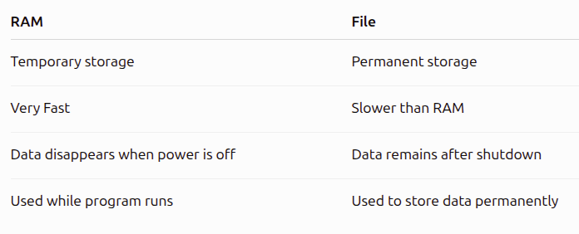

Slide 4
Types of Files
Python mainly works with two types of files.
Text File
  A text file stores information in the form of readable characters.
  Humans can easily read it using editors like
  Notepad VS Code Sublime Text PyCharm
Characteristics
  Human readable
  Stores characters
  Uses encoding
  Easy to edit

Slide 5
Binary File
  Binary files store data as raw bytes.
  Humans cannot read binary files directly.
Characteristics
  Stores bytes
  Fast
  Compact
  Not human readable

Slide 6
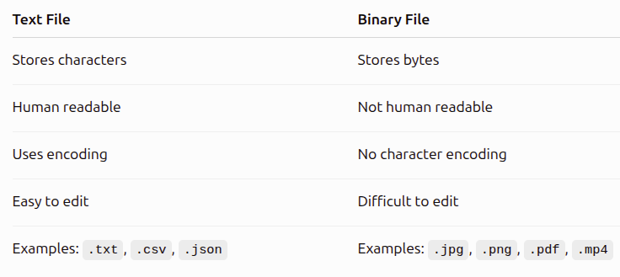

Slide 7
What is File Handling?
File Handling is the process of performing operations on files.
These operations include
  Creating a file
  Opening a file
  Reading data
  Writing data
  Updating data
  Closing a file

Slide 8
Steps in File Handling
Every file operation follows the same sequence.
Open File → Read / Write → Close File
This is known as the File Handling Cycle.
f = open("student.txt") → open() returns a file object.
Perform Operations Once opened.
Close the File
Because, Python releases
  Memory
  Buffer
  Operating System resource

Slide 9
What Happens If You Don't Close a File?
Memory leak
File lock
Unsaved data
Buffer not flushed
Resource wastage

Slide 10
The with Statement
Python provides a better way to work with files.
with open("data.txt") as f:
  data = f.read()
Python automatically closes the file.
Even if an exception occurs,
Python automatically closes the file.

Slide 11
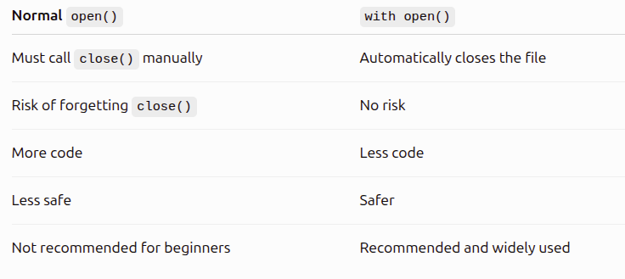

Slide 12
File Modes in Python
We learned how to open a file using open(). But opening a file is not enough.
Python also needs to know what operation you want to perform on the file.
For example:
  Read the file?
  Write to the file?
  Add new data?
  Create a new file?
  Read and Write together?
  This is done using File Modes.

Slide 13
What is a File Mode?
A File Mode tells Python how a file should be opened and what operations are allowed on that file.
  f = open("student.txt", "r")
Types of File Modes
Python provides several file modes.
File Modes
  r, w, a, x, r+, w+, a+
  rb, wb, ab, rb+, wb+, ab+

Slide 14
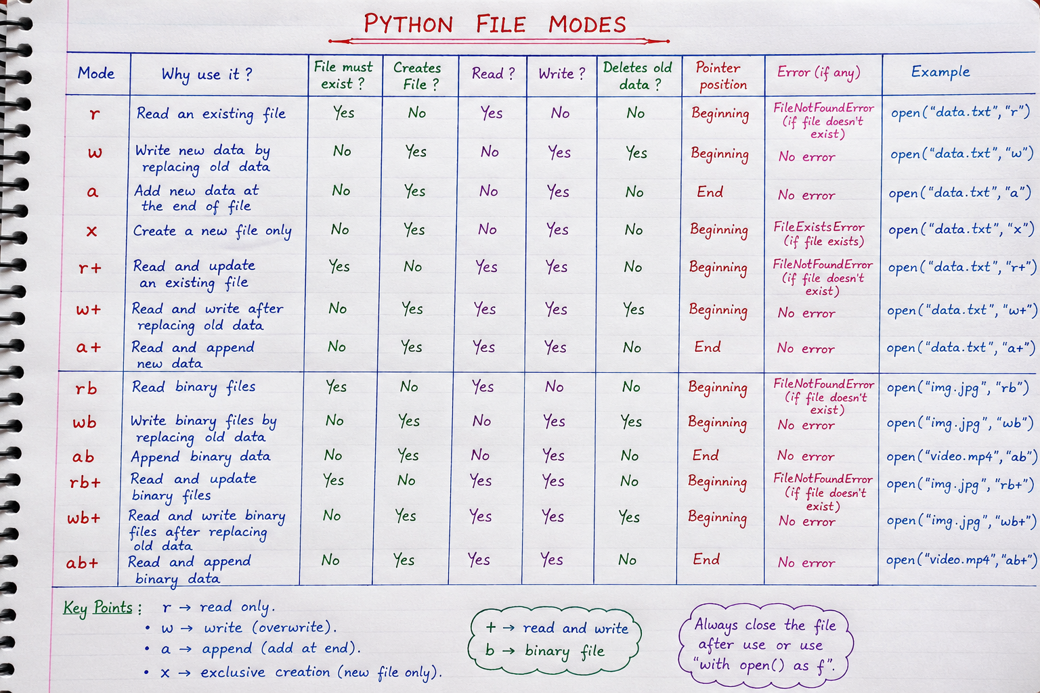

Slide 15
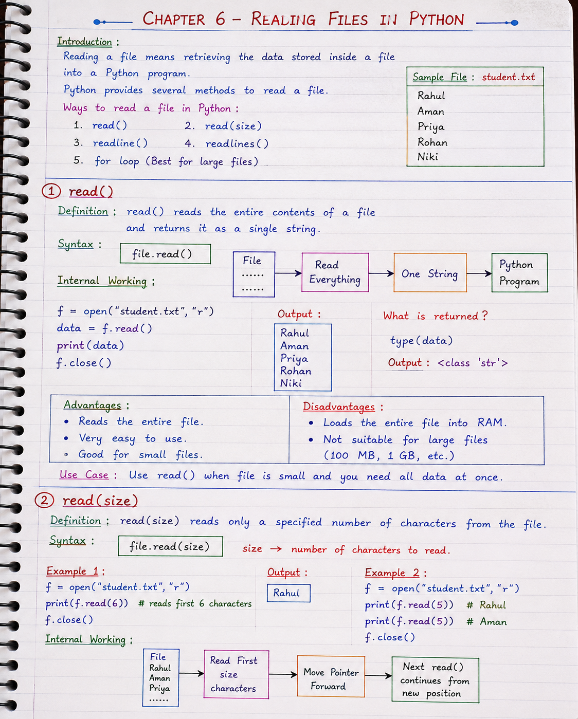

Slide 16
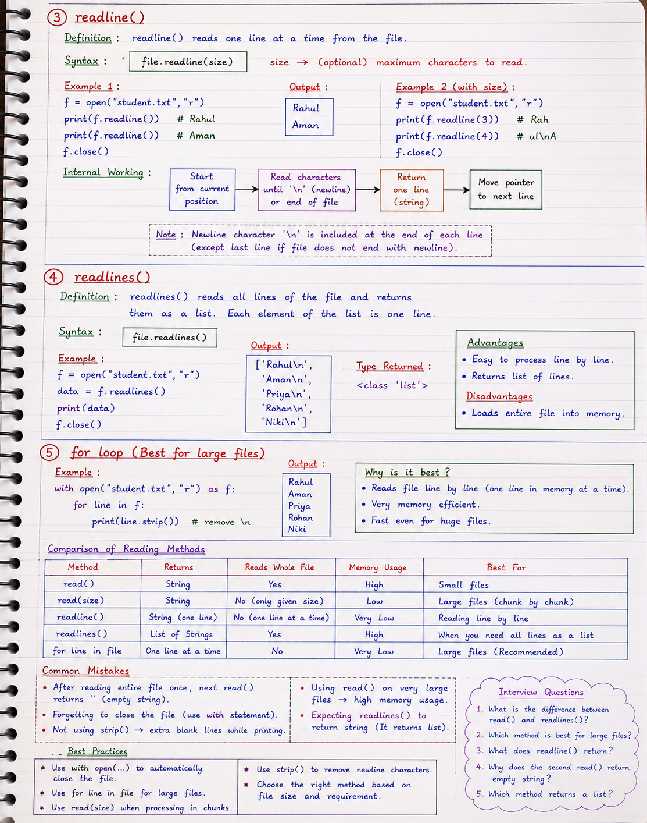

Slide 17
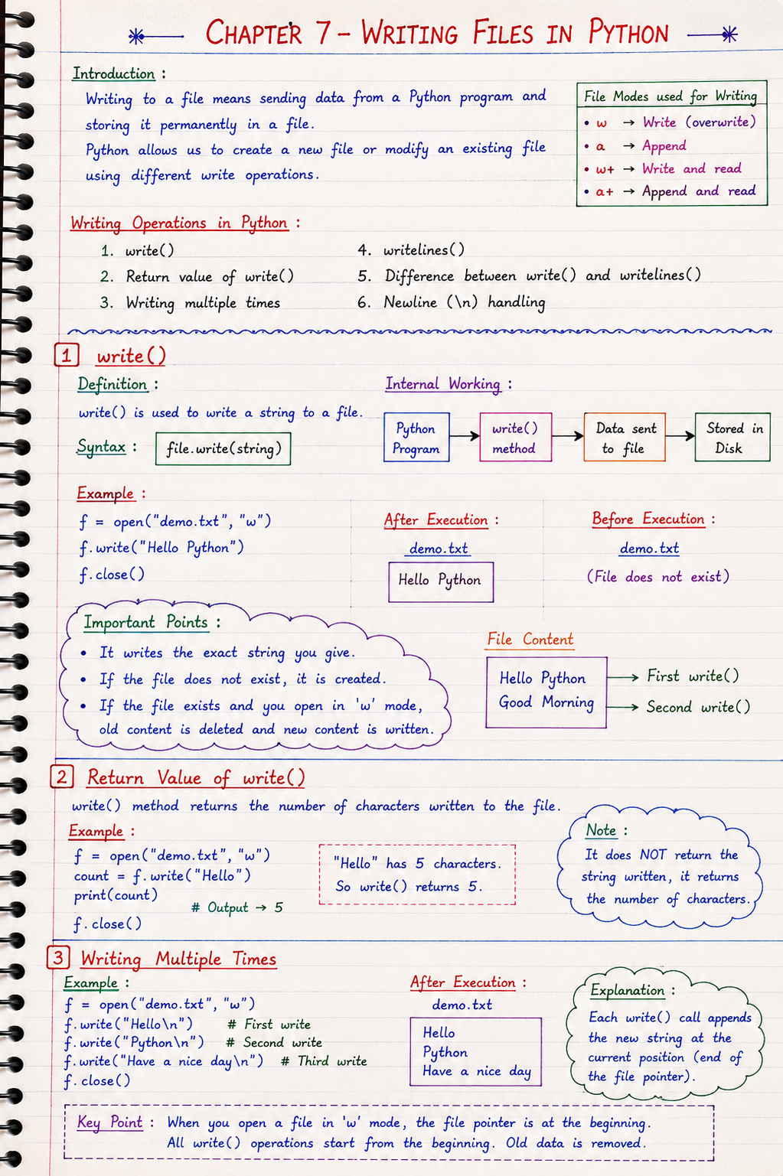

Slide 18
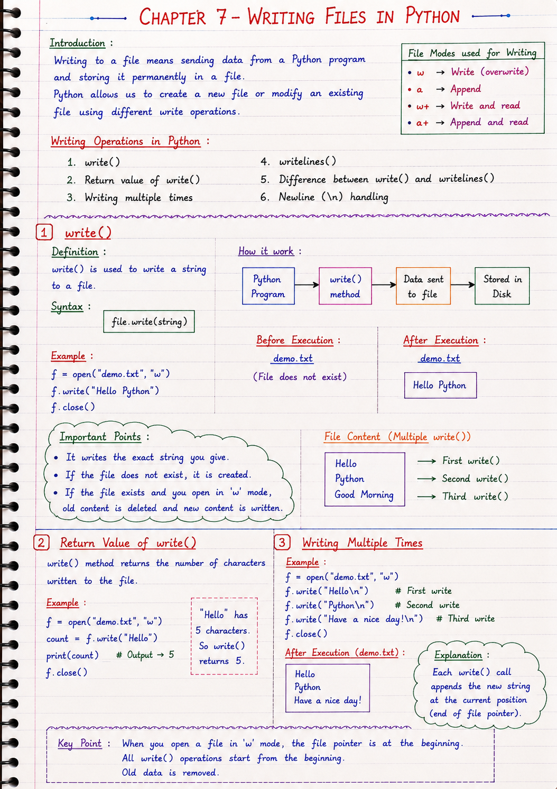

Slide 19
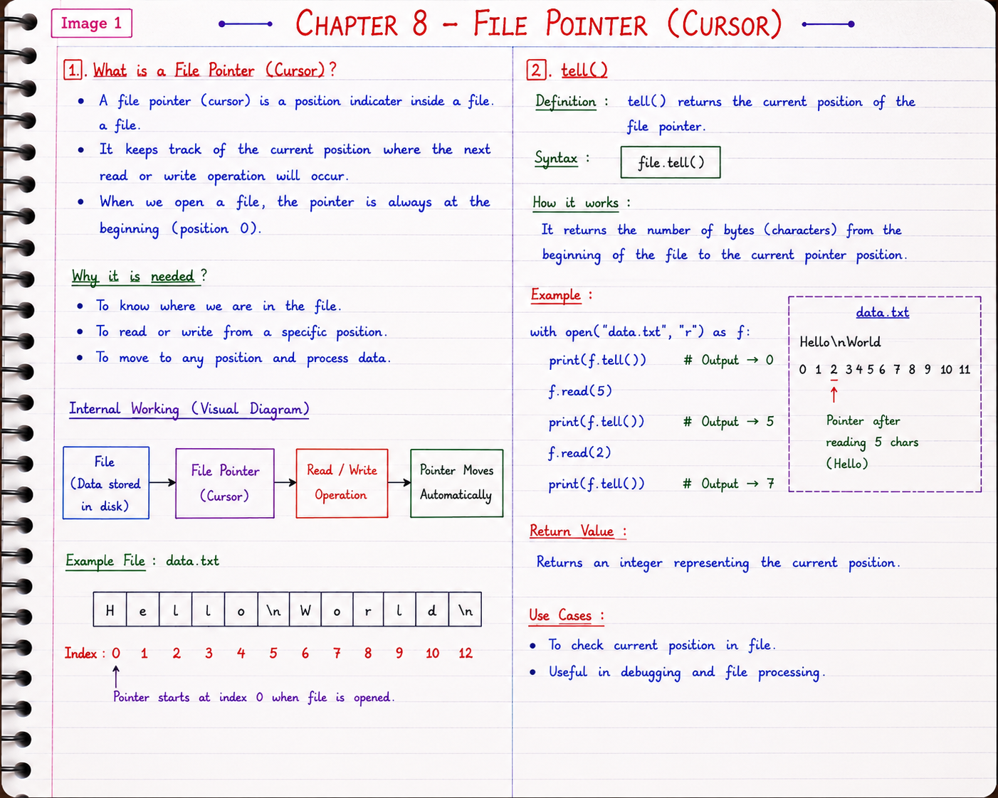

Slide 20
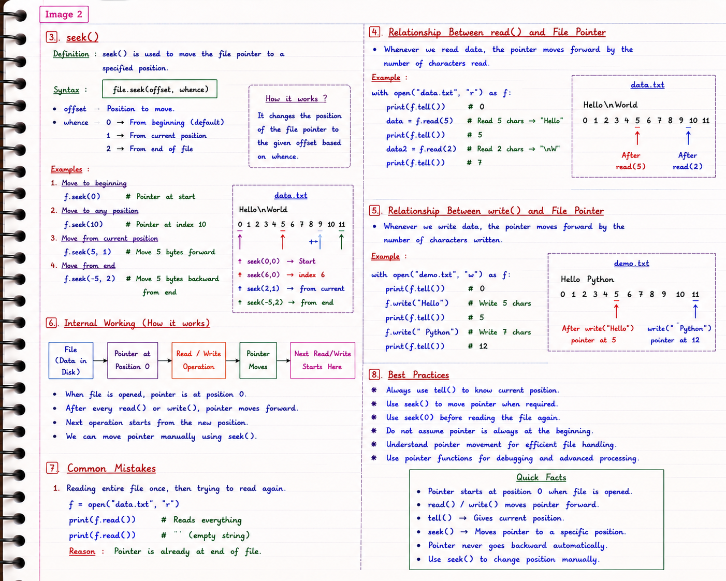

Slide 21
